Slide 1

Training on Phonetics for Teachers

Slide 2

Introduction
Phonetics is the study of speech sounds
Helps in understanding how sounds are produced, transmitted, and perceived
Essential for clear communication and effective teaching
Teachers can guide students towards accurate pronunciation

Slide 3
Why we need phonetics in teaching
Bridges the Gap Between Spoken and Written English
Reduces Mother-Tongue Interference
Builds Listening and Speaking Skills
Helps in clear Communication

Slide 4
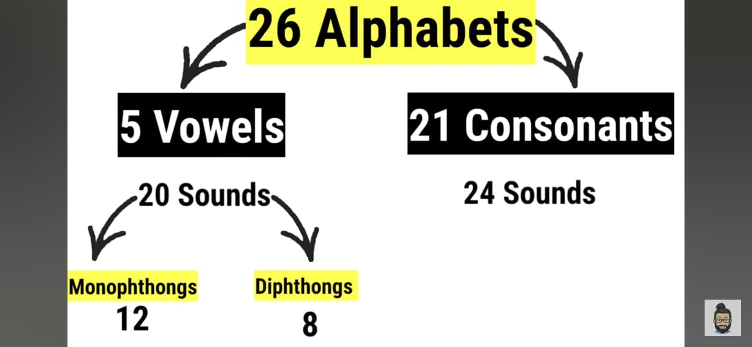
Types of sounds in phonetics

Slide 5
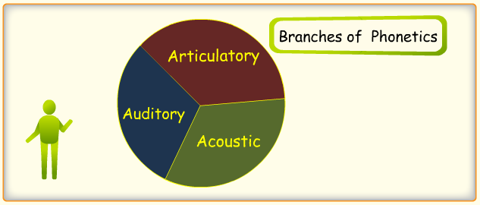

Slide 6
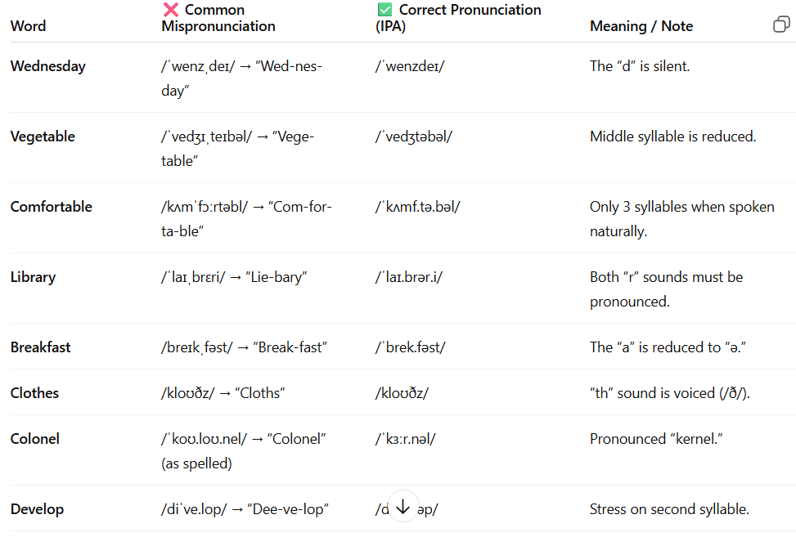
COMMONLY MISPRONOUNCED WORDS

Slide 7
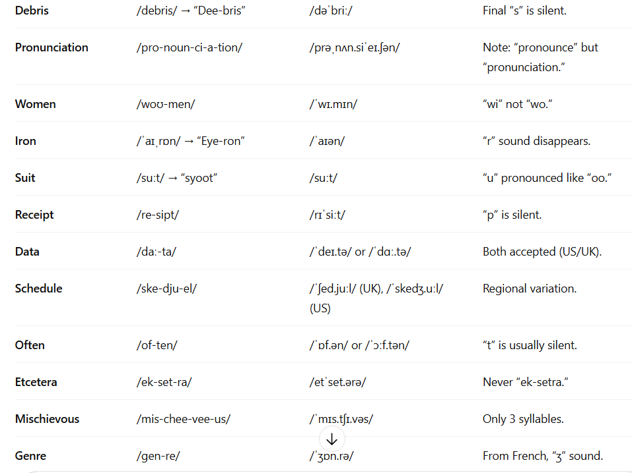

Slide 8
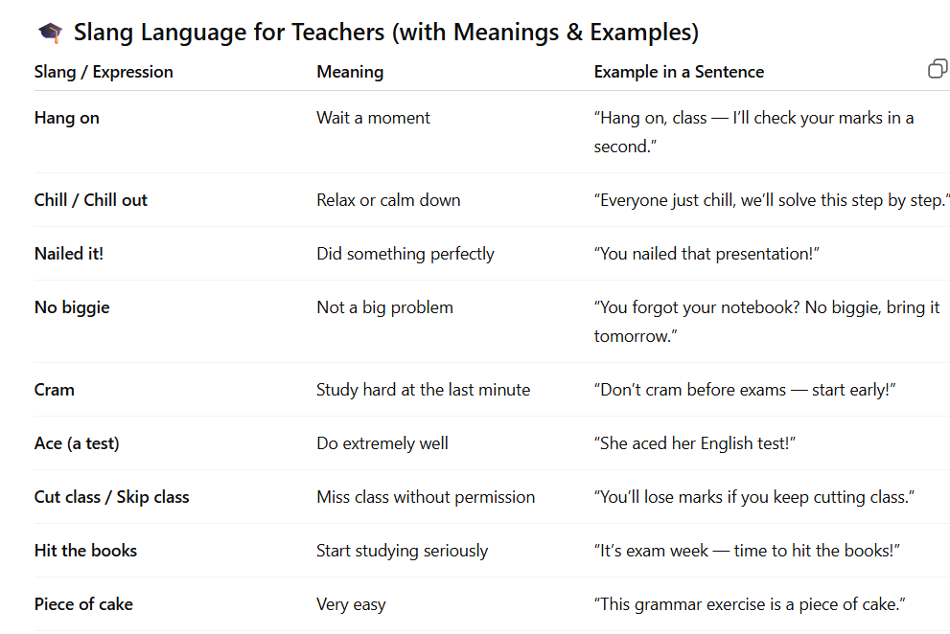

Slide 9
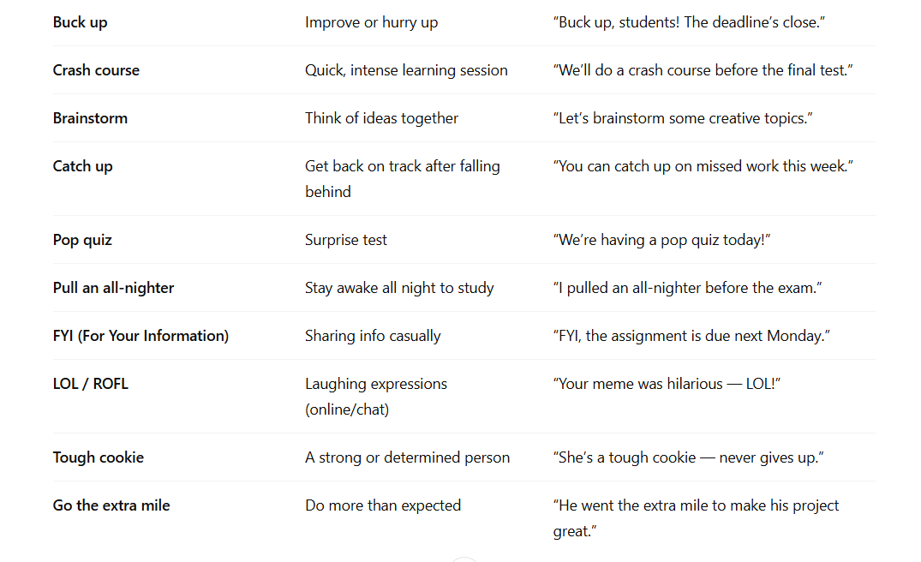

Slide 10
ACTIVITY TIME
Sally saw Susie sitting in a shoe shine shop.
Three thin thieves thought a thousand thoughts.
Truly rural.
Giggling girls go gathering geese.

Slide 11
Benefits of Phonetic Training for Teachers
Helps teachers model correct pronunciation
Makes classroom instructions clearer
Enhances teachers’ professional competence
Builds credibility and authority in language teaching
Reduces communication barriers in multilingual classrooms

Slide 12
Importance of Phonetics in Teaching
Improves pronunciation and fluency.
Enhances listening skills.
Builds confidence in speaking English.
Reduces influence of mother tongue.
Encourages Effective Communication.
Makes Learning English Enjoyable

Slide 13
How Teachers Can Use Phonetics in the Classroom
• Introduce phonetic symbols alongside new vocabulary
• Teach students to break words into sounds (phonemic awareness)
• Provide real-life practice with dialogues and role play
• Use technology and apps to reinforce phonetic learning

Slide 14
Teaching Strategies for Phonetics
1. Demonstration Method
2. Drilling Method
3. Visual Aids
4. Listening Practice
5. Games/Activities
6. Minimal Pair Practice

Slide 15
Challenges in TeachinG Phonetics
Students may find phonetic difficult at first
Influence of mother tongue interference
Limited time in curriculum for pronunciation practice
Lack of resources like audio labs or software
Teachers need continuous training to stay updated

Slide 16
Conclusion
Phonetics is vital for effective language teaching
Teachers should focus on correct pronunciation
Regular practice helps teachers/students achieve fluency
A confident speaker is an effective learner

